Slide 1
K-Nearest Neighbor
Udemy machine learning a-z

Slide 2
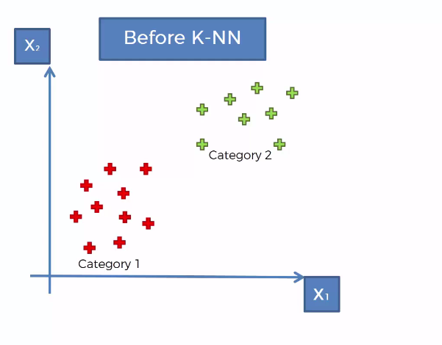
We have known categories with two features

Slide 3
What if we have new data point and we do not know it category but we know the values of features or attributes.

Slide 4
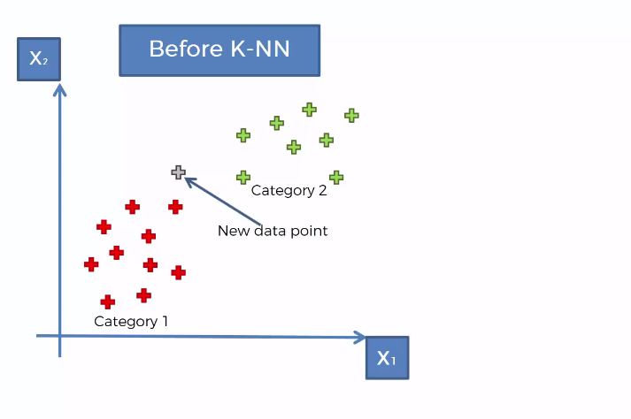
How to classify new data point ?

Slide 5
How to classify new data point ?
How do we classified new data point ?
This is learning from the data.
So your first algorithm from learning of data is KNN.

Slide 6
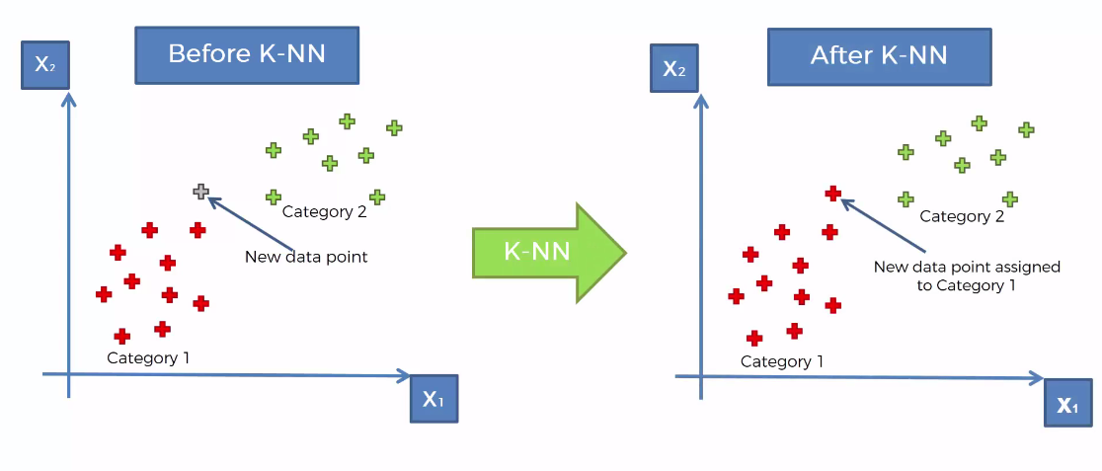
K-Nearest Neighbor

Slide 7
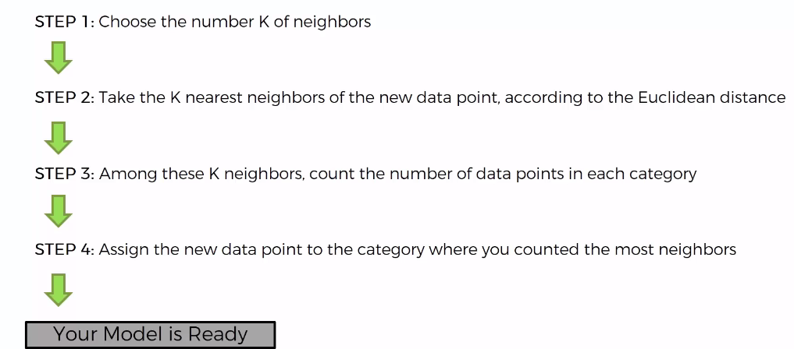
Algorithm

Slide 8
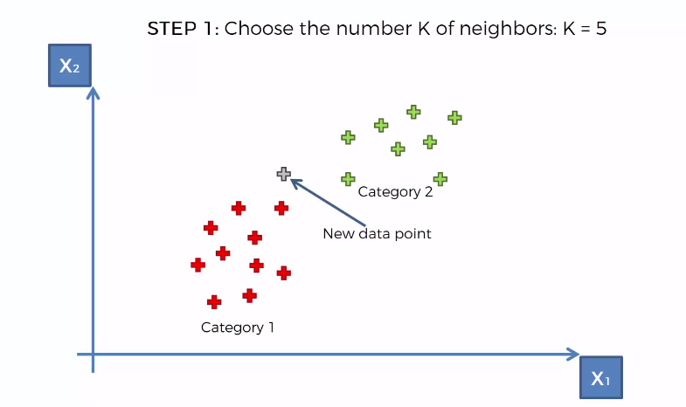
Step 1

Slide 9
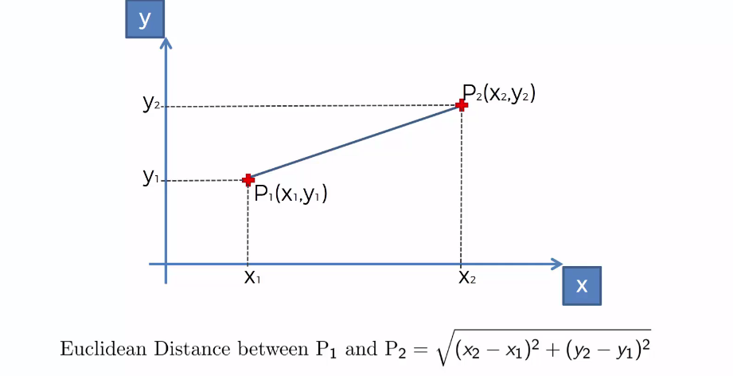
Step 2: Find the nearest neighbor (Euclidean Distance)

Slide 10
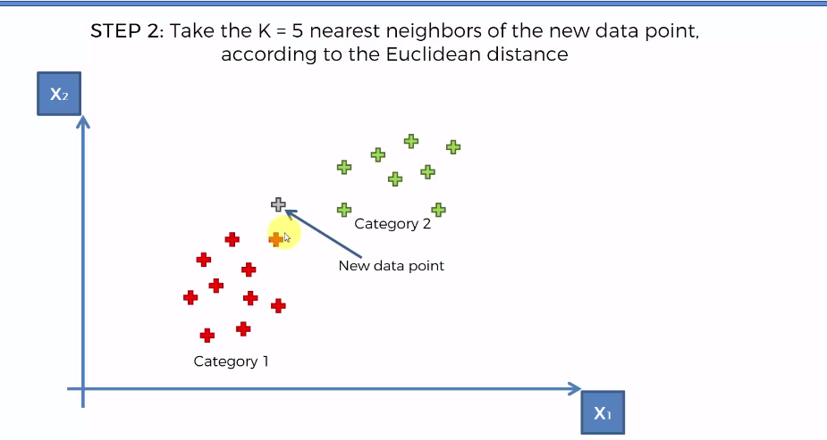
Step 2: Find the nearest neighbor (Euclidean Distance)

Slide 11
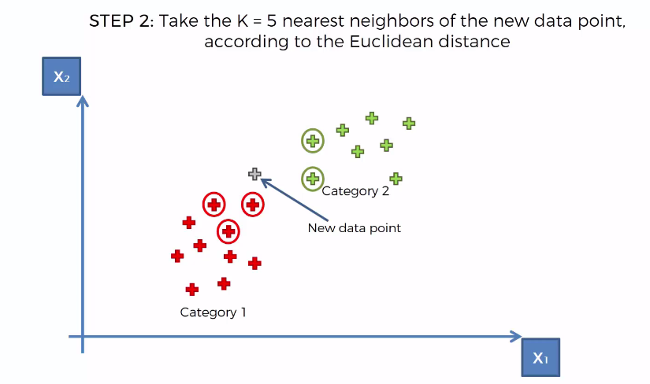
Step 2: Find the nearest neighbor (Euclidean Distance)

Slide 12
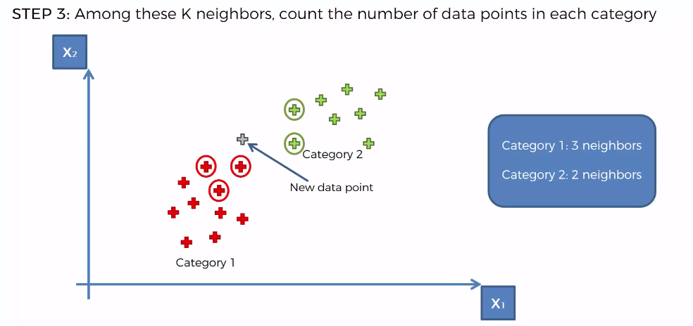
Step 3

Slide 13
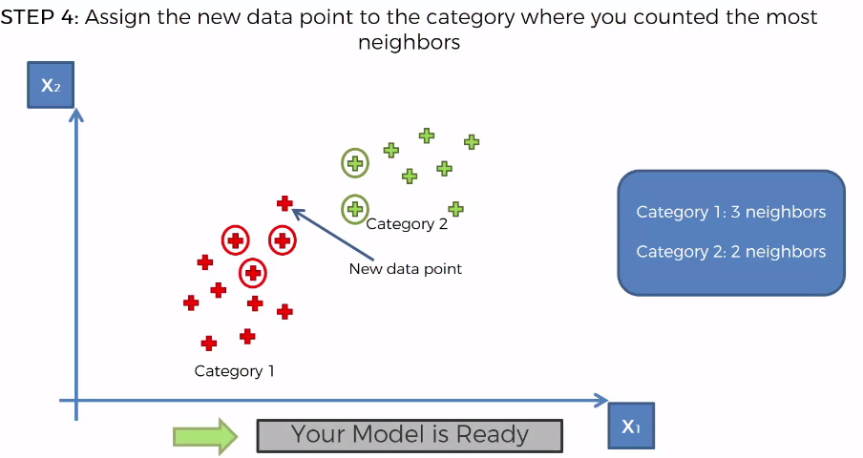
Step 4

Slide 14
Example taken from::
https://people.revoledu.com/kardi/tutorial/KNN/KNN_Numerical-example.html

Slide 15
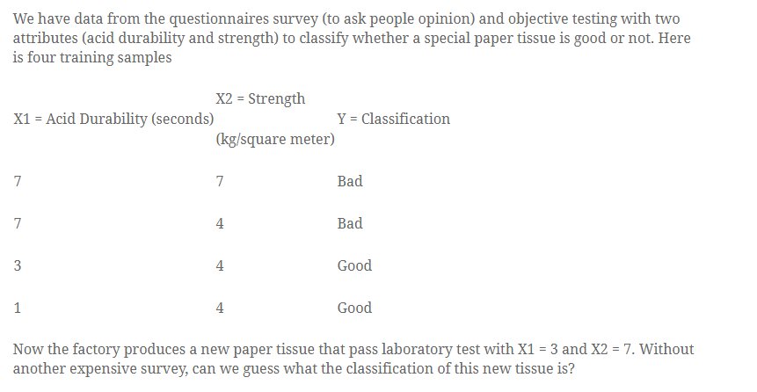
Let K=3 solve

Slide 16
solution

Slide 17
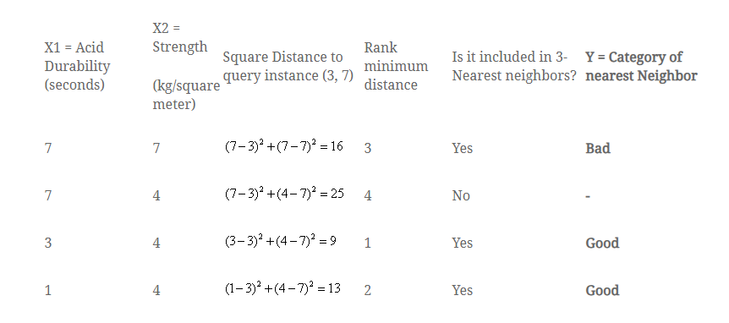

Slide 18
